Slide 1
K-Nearest Neighbors KNN

Slide 2
Objectives
What is KNN?
Steps involved in KNN

Slide 3
What is KNN?
K-nearest neighbors (KNN) is a supervised technique that can be used for classification or regression.
We will only look into KNN for classification.

Slide 4
Steps Involved in KNN?
Distance between the test point and all the other points is computed and the distances are arranged from lowest to highest.
Based on the number of neighbors, the majority class label is assigned to the test point.

Slide 5
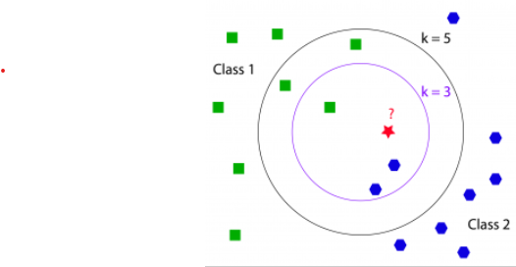
How Does it Work?

Slide 6
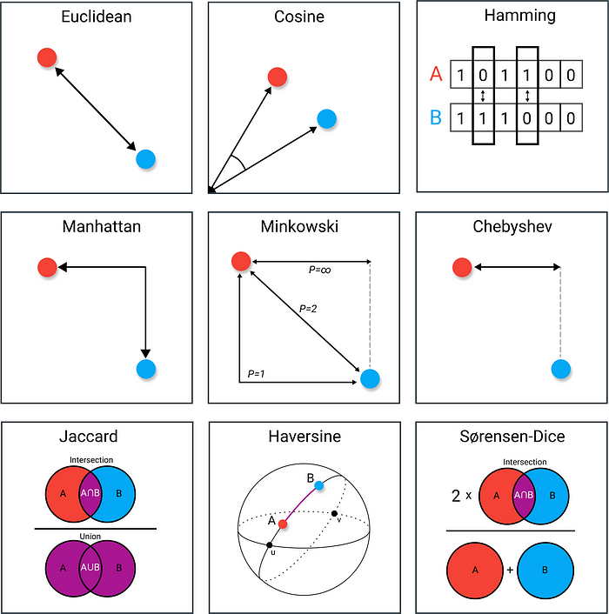

Different Distance Measures
Manhattan Distance
(2,3) and (7,9)
|2-7| + |3-9| = 5 + 6 = 11
Euclidean Distance – Is mostly used
(2,3) and (7,9)
$\sqrt{{\left(2−7\right)}^{2}+{\left(3−9\right)}^{2}}$= $\sqrt{25+36}$ = $\sqrt{61}$= 7.81
Cosine Distance
(2,3) and (7,9)
Cos(θ) = $\frac{a.b}{\text{||}\text{a}\text{||.||}\text{b}\text{|| }}$
Cos (θ) = $\frac{\text{(2*7+3*9)}}{(\sqrt{2^{2}+3^{2} } ∗ \sqrt{7^{2}+9^{2} }\text{ )}}$
= $\frac{\text{41}}{(\sqrt{13 } ∗ \sqrt{130 }\text{ )}}$ = 0.99

Slide 7
Conclusion
KNN will not work on a multiclass classifier if the class labels are too many.
KNN will also not work when the dataset is very large.

Slide 8
References
https://www.datacamp.com/community/tutorials/k-nearest-neighbor-classification-scikit-learn
http://www.coxdocs.org/doku.php?id=perseus:user:activities:matrixprocessing:learning:classificationparameteroptimization
https://en.wikipedia.org/wiki/K-nearest_neighbors_algorithm

